Slide 1



Software Engineering
(#2301CS405)
Unit-3 Software Analysis
& Design
Prof. R. B. Gondaliya
Computer Engineering Department
Rajkumar.gondaliya@darshan.ac.in
+ 91-9723232741

Slide 2
Software Analysis
Section 1

Slide 3

Looping
Outline
Requirement Engineering
Software Requirements Specification
Eliciting Requirements
Developing Use case
Requirement Modeling

Slide 4



Requirements analysis is hard
“The hardest single part of building a software system is deciding what to build. No part of the work so cripples the
resulting system if done wrong.”
“The seeds of major software disasters are usually sown in the
first three months of commencing the software project.”
What is Requirement Engineering?
Tasks and techniques that lead to an understanding of requirements is called requirement engineering.
"Fred" Brooks Jr. is an American computer architect, software engineer, and computer scientist, best known for managing the development of IBM's System/360 family of computers
Capers Jones is an American specialist in software engineering methodologies

Slide 5
Requirement Engineering
It provides the appropriate mechanism for understanding
What customer wants
Analyzing needs
Assessing feasibility
Negotiating a reasonable solution
Specifying solution unambiguously
Validating the specification
Managing requirements

Slide 6
Functional requirements
Non-functional requirements
Any requirement which specifies what the system Should do.
Any requirement which specifies how the system performs a certain function.
A functional requirement will describe a particular behavior of function of the system when certain conditions are met, for example: “Send email when a new customer signs up” or “Open a new account”.
A non-functional requirement will describe how a system should behave and what limits there are on its functionality.
Typical functional requirements
Typical non-functional requirements
Business Rules
Administrative functions
Historical Data
Response time
Availability
Regulatory
Transaction corrections, adjustments and cancellations
Legal or Regulatory Requirements
Throughput
Reliability
Manageability
Utilization
Recoverability
Environmental
External Interfaces
Reporting Requirements
Authentication
Static volumetric
Maintainability
Data Integrity
Authorization levels
Scalability
Serviceability
Usability
Audit Tracking
Capacity
Security
Interoperability

Slide 7

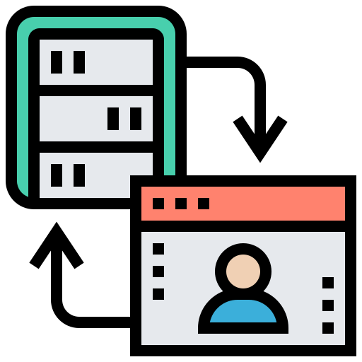

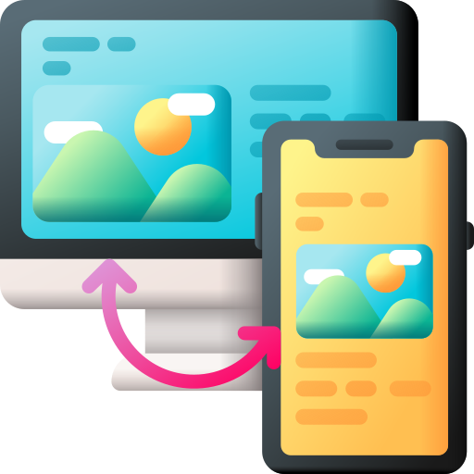
Functional requirements
Non-functional requirements
The website will have a homepage.
The home page should load within 1.5 seconds
The website will store customer data
Customer data should be encrypted to level 3 encryption standard.
Website customers can login into their accounts.
The website has the capacity for 5k logged-in users at any one time.
Customer can access the website on their phones.
The website should be compatible with iOS 13 and above.

Slide 8
Library Management System
Function Requirements
Non-function Requirements
Add Article: New entries must be entered in database
Update Article: Any changes in articles should be updated in case of update
Delete Article: Wrong entry must be removed from system
Inquiry Members: Inquiry all current enrolled members to view their details
Inquiry Issuance: Inquiry all database articles
Check out Article: To issue any article must be checked out
Check In article: After receiving any article system will reenter article by Checking
Inquiry waiting for approvals: Librarian will generates all newly application which is in waiting list
Reserve Article: This use case is used to reserve any book with the name of librarian, it can be pledged
Safety Requirements: The database may get crashed at any certain time due to virus or operating system failure. So, it is required to take the database backup.
Security Requirements: We are going to develop a secured database for the university. There are different categories of users namely teaching staff, administrator, library staff ,students etc., Depending upon the category of user the access rights are decided.
Software Constraints: The development of the system will be constrained by the availability of required software such as database and development tools. The availability of these tools will be governed by

Slide 9



Requirements Engineering Tasks
1
Inception
2
Elicitation (Requirement Gathering)
3
Elaboration
Roughly define scope
Define requirements
Further define requirements
A basic understanding of a problem, people who want a solution, the nature of solution desired
The practice of collecting the requirements of a system from users, customers and other stakeholders
Expand and refine requirements obtained from inception & elicitation
Creation of User scenarios, extract analysis class and business domain entities

Slide 10


Requirements Engineering Tasks Cont.
4
Negotiation
5
Specification
Reconcile conflicts
Create analysis model
Agree on a deliverable system that is realistic for developers and customers
It may be written document, set of graphical models, formal mathematical model, collection of user scenarios, prototype or collection of these
SRS (Software Requirement Specification) is a document that is created when a detailed description of all aspects of software to build must be specified before starting of project

Slide 11
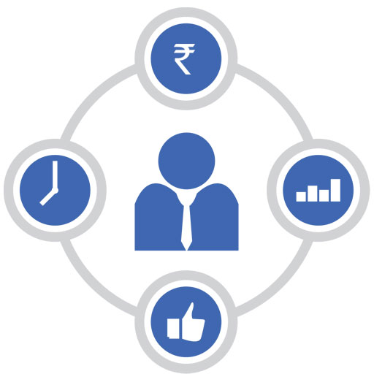

Requirements Engineering Tasks Cont.
6
Validation
7
Requirements Management
Ensure quality of requirements
It is a set of activities to identify, control & trace requirements & changes to requirements (Umbrella Activities) at any time as the project proceeds.
Review the requirements specification for errors, ambiguities, omissions (absence) and conflicts

Slide 12
Example to illustrate an ambiguous requirement:
Imagine a software development project where the client requests a feature that states "The system should be fast."
This requirement is ambiguous because "fast" is a subjective term that can mean different things to different people.
Without a clear definition of what "fast" means in this context (e.g., response time, loading time, processing speed), the development team may struggle to implement the feature correctly.
To make this requirement less ambiguous, it would be better to specify measurable criteria such as "The system should load a webpage in under 2 seconds"

Slide 13



Elicitation is the Hardest Part!
Project Inception
Problems of scope
System boundaries are ill-defined
Customers will provide irrelevant information
Problems of understanding
Customers never know exactly what they want
Customers don’t understand capabilities and limitations
Customers have trouble fully communicating needs
Problems of volatility
Requirements always change
During the initial project meetings, the following tasks should be accomplished
Identify the project stakeholders
These are the folks we should be talking to
Recognize multiple viewpoints
Stakeholders may have different (and conflicting) requirements
Work toward collaboration
It’s all about reconciling conflict
Ask the first questions
Who? What are the benefits? Another source?
What is the problem? What defines success? Other constraints?
Am I doing my job right?

Slide 14
Collaborative Elicitation
Elicitation work products
Collaborative elicitation should result in several work products
A bounded statement of scope
A list of stakeholders
A description of the technical environment
A list of requirements and constraints
Any prototypes developed
A set of use cases
One-on-one Q&A sessions rarely succeed in practice; collaborative strategies are more practical
Characterize how users will interact with the system
Use cases tie functional requirements together

Slide 15
Quality Function Deployment (QFD)
This is a technique that translates the needs of the customer into technical requirements for software
It emphasizes an understanding of what is valuable to the customer and then deploys these values throughout the engineering process through functions, information, and tasks
It identifies three types of requirements
Normal requirements: These requirements are the objectives and goals stated for a product or system during meetings with the customer
Expected requirements: These requirements are implicit to the product or system and may be so fundamental that the customer does not explicitly state them
Exciting requirements: These requirements are for features that go beyond the customer's expectations and prove to be very satisfying when present

Slide 16

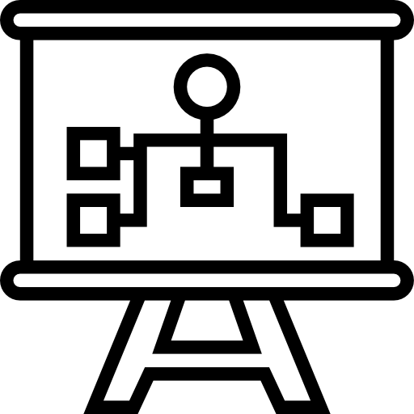
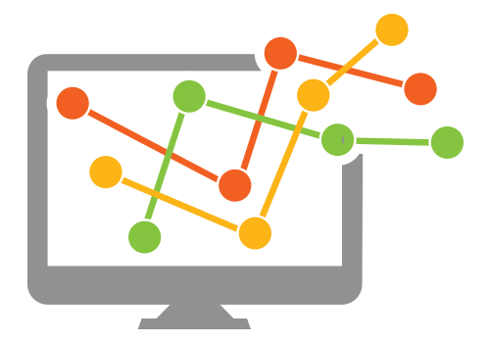
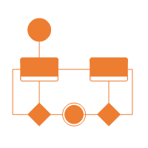
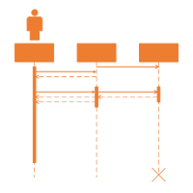
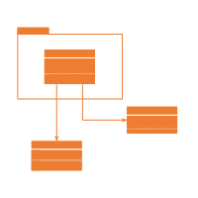
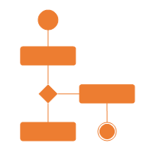
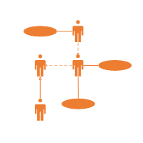
The requirement analysis model
Purpose
Describe what the customer wants built
System Information
Establish the foundation for the software design
System Function
Provide a set of validation requirements
System Behaviors

Slide 17

Analysis rule of Thumb
Elements of the Requirements Model
Make sure all points of view are covered
Every element should add value
Keep it simple
Maintain a high level of abstraction
Focus on the problem domain
Minimize system coupling
Model should provides value to all stakeholders
Scenario-based Models
e.g.
Use cases
User Stories
Class Models
e.g.
Class diagrams
Collaboration diagrams
Software
Requirements
Behavioral Models
e.g.
State diagrams
Sequence diagrams
Flow Models
e.g.
DFDs
Data models

Slide 18
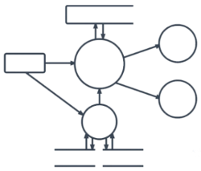
Elements of the Requirements Model Cont.
Scenario-based elements
Behavioral elements
Describe the system from the user's point of view using scenarios that are stated in use cases and activity diagrams
Use state diagrams to represent the state of the system, the events that cause the system to change state, and the actions that are taken as a result of a particular event. This can also be applied to each class in the system.
Class-based elements
Identify the domain classes for the objects manipulated by the actors, the attributes of these classes, and how they interact with one another; which utilize class diagrams to do this.
Flow-oriented elements
Use data flow diagrams to show the input data that comes into a system, what functions are applied to that data to do transformations, and what resulting output data are produced.
Use Case Diagram
Activity Diagram
Class Diagram
State Diagram
Data Flow Diagram

Slide 19
Characteristics of a Good SRS
SRS should be accurate, complete, efficient, and of high quality, so that it does not affect the entire project plan.
An SRS is said to be of high quality when the developer and user easily understand the prepared document.
Characteristics of a Good SRS:
Correct
Unambiguous
Complete
SRS is correct when all user requirements are stated in the requirements document.
SRS is unambiguous when every stated requirement has only one interpretation.
SRS is complete when the requirements clearly define what the software is required to do.
Note that there is no specified tool or procedure to assure the correctness of SRS.

Slide 20
Characteristics of a Good SRS Cont.
Ranked for Importance/Stability
Modifiable
All requirements are not equally important, hence each requirement is identified to make differences among other requirements.
The requirements of the user can change, hence requirements document should be created in such a manner that those changes can be modified easily.
Stability implies the probability of changes in the requirement in future.
Traceable
Verifiable
Consistent
SRS is traceable when the source of each requirement is clear and facilitates the reference of each requirement in future.
SRS is verifiable when the specified requirements can be verified with a cost-effective process to check whether the final software meets those requirements.
SRS is consistent when the subsets of individual requirements defined do not conflict with each other.

Slide 21
Problems Without SRS
Without developing the SRS document, the system would not be properly implemented according to customer needs.
Software developers would not know whether what they are developing is what exactly is required by the customer.
Without SRS, it will be very difficult for the maintenance engineers to understand the functionality of the system.
It will be very difficult for user document writers to write the users’ manuals properly without understanding the SRS.

Slide 22
Standard Template for writing SRS
1. Introduction
1.1 Purpose
1.2 Document Conventions
1.3 Intended Audience and Reading Suggestions
1.4 Project Scope
1.5 References
2. Overall Description
2.1 Product Perspective
2.2 Product Features
2.3 User Classes and Characteristics
2.4 Operating Environment
2.5 Design and Implementation Constraints
2.6 User Documentation
2.7 Assumptions and Dependencies
3. System Features
3.1 System Feature 1
3.2 System Feature 2 (and so on)
4. External Interface Requirements
4.1 User Interfaces
4.2 Hardware Interfaces
4.3 Software Interfaces
4.4 Communications Interfaces
5. Other Nonfunctional Requirements
5.1 Performance Requirements
5.2 Safety Requirements
5.3 Security Requirements
5.4 Software Quality Attributes
6. Other Requirements
Appendix A: Glossary | Appendix B: Analysis Models | Appendix C: Issues List

Slide 23
Software Design
Section 2

Slide 24

Looping
Outline
What is Design?
Software design work products
Characteristics of good Design
Design Models
The FURPS quality attributes
Design Concepts
Design Principles
Architectural Design & Styles
Component Level or Procedural Design
Cohesion & Coupling
User Interface Design
Golden Rules of User Interface Design
Web Application Design

Slide 25
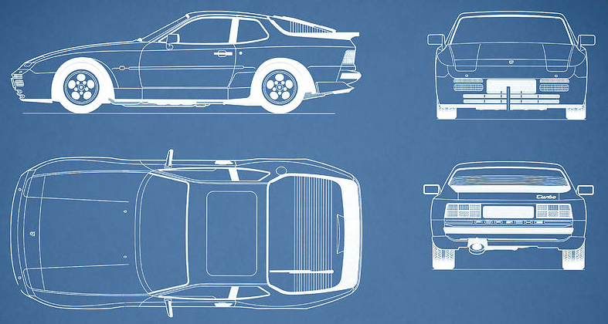
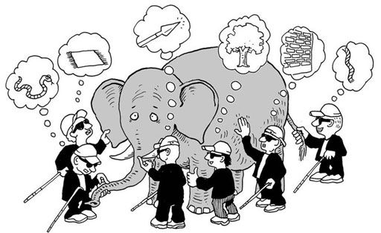
What is Design?
A meaningful representation of something to be built
It's a process by which requirements are translated into blueprint for constructing a software
Blueprint gives us the holistic view (entire view) of a software
SRS
Design
Process
Software
Design
Problem
Domain
Solution
Domain

Slide 26
Design Concepts
The beginning of wisdom for a software engineer is to recognize the difference between getting a program to work and getting it right
Fundamental software design concepts provide the necessary framework
for
“getting it right.”
Each design concept helps to answer the following questions
What criteria can be used to partition software into individual components?
How is function or data structure detail separated from a conceptual representation of the software?
What uniform criteria define the technical quality of a software design?

Slide 27
Design Concepts
Design creates a representation or model of the software, but unlike the requirement model
The requirement model focuses on describing required data, function, and behaviour.
The design model provides details about software architecture, data structure, interface, and components that are necessary to implement the system.
Who does it?
Software engineers conduct each of the design tasks.
Why is it important?
Design model can assessed for quality and improved before code is generated, tests are conducted, and end-users become involved.

Slide 28


Software Design Process?
Software design is the most creative part of the development process
Requirement
Engineering
Analysis
Model
(What?)
Design
Engineering
Design
Model
(How?)
Process involves
Diversification & Convergence
Blue Print for Constructing Software

Slide 29
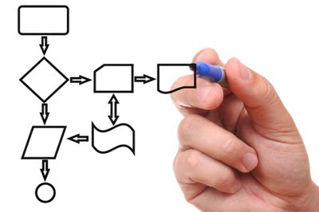
Software design work products
Characteristics of good Design
For a design to be easily implemented in a conventional programming language, the following items must be designed during the design phase.
The design must implement all explicit requirements available in the requirement model
The design must accommodate all implicit requirements given by stakeholders
The design must be readable & understandable
The good design should provide complete picture of the software, addressing the data, functional and behavioral domains.
Different modules required to implement the design solution.
Control relationship among the identified modules. The relationship is also known as the call/invocation relationship among modules.
Interface among different modules. The interface among different modules identifies the exact data items exchanged among the modules.
Algorithms required to implement each individual module.
Data structures of the individual modules.

Slide 30
Important Software Design Concepts
Abstraction - Hide Irrelevant data
Modularity - subdivide the system
Architecture - design a structure of something
Refinement - removes impurities
Pattern - a Repeated form
Information Hiding - Hide the Information so that it cannot be accessed by an unwanted party
Refactoring - Reconstruct something

Slide 31
Abstraction
Abstraction simply means to hide the details to reduce complexity and increase efficiency or quality.
Abstraction can be used for existing elements as well as the components being designed.
There are two common abstraction mechanisms
Functional Abstraction:
Data Abstraction
Functional abstraction means that a module is defined by what it does, not how it does it. The inner workings and algorithms of the module are hidden from the user, who only needs to know what function the module performs.
Imagine a function in a program that calculates the square root of a number, you don't need to know how it calculates the square root, just that it does.

Slide 32
Abstraction Cont.
Data abstraction means the details of data elements are hidden from the users. It forms the basis for object-oriented design approaches.
Consider a class in an object-oriented program that represents a Bank Account.
The details of Account Number and Balance are hidden within the class.
Users of the Bank Account class interact with the account through methods like deposit, withdraw, and getBalance without needing to know the internal structure of the data.

Slide 33
Modularity
Divide the software into distinct, independent modules that can be developed, tested, and maintained separately.
Single large programs are difficult to understand and read due to a large number of reference variables, control paths, global variables, etc.
For Example
In library management system modules are User Management, Book Management, Borrowing System, etc.
The benefit of modularity is that changes in one module (e.g., adding a new book feature) do not affect other modules.

Slide 34
Architecture
Architecture is a technique to design a structure of something.
In software design, architecture focuses on the elements and data within the structure. These components interact and use the data to perform functions.
Example: Imagine a website with three main parts
Frontend (what users see)
Backend (server and database)
Database (stores data)
In this architecture:
The Frontend interacts with users and sends requests to the Backend.
The Backend processes these requests and interacts with the Database.
The Database stores and retrieves data as needed.

Slide 35
Refinement
Refinement means improving something by removing impurities and increasing its quality.
In software design, refinement is the process of developing or presenting the software in more detail, identifying and fixing errors to enhance quality.
Imagine you are building a mobile app
Initial Design: You create a basic version of the app with core features.
Refinement: You test the app and find some bugs and areas for improvement.
Improvement: You fix the bugs and add more details to the app, like better user interface elements and additional features.
Through refinement, the app becomes more polished and functional, ensuring a higher quality product.

Slide 36
Pattern
Pattern means a repeated design or form. In design, a pattern refers to using the same solution to solve similar problems in different situations.
Imagine you're designing websites
Header Design Pattern:
You use the same layout for the header on multiple pages—logo on the left, navigation menu in the middle, and contact info on the right.
Button Design Pattern:
You use the same style and behavior for buttons across the site—rounded corners, a specific color, and hover effects.
By applying these patterns, you create a consistent look and feel, making the design process more efficient and cohesive.

Slide 37
Information Hiding
Information Hiding means keeping certain details hidden so that they cannot be accessed by unauthorized parts.
In software design, it involves designing modules so that each module keeps its information private and only shares what is necessary.
Imagine a bank account system
Account Module: Contains sensitive details like account number and balance.
Transaction Module: Allows depositing and withdrawing money but does not access or show account details directly.
Here, the Account Module hides the sensitive information. The Transaction Module interacts with the Account Module but doesn't see the internal details, maintaining privacy and security.

Slide 38
Refactoring
Refactoring means improving the design or structure of something without changing how it works.
In software design, refactoring involves simplifying and organizing code to make it easier to understand and maintain, while ensuring it still functions the same way.
Imagine you have a software application with complex and messy code.
Before Refactoring: The code is difficult to read and maintain, with redundant sections and unclear organization.
After Refactoring: You reorganize and clean up the code, making it more readable and efficient, but the application still performs the same tasks and behaves the same way.

Slide 39
Design Models
It is creative activity. It is most critical activity during system development
Analysis Models
Has great impact on testing and maintenance
Scenario-based elements
Use cases - text
Use-case diagrams
Activity diagrams
Swimlane diagrams
Design document forms reference for later phases
Flow-oriented elements
Data flow diagrams
Control-flow diagrams
Processing narratives
Procedural
Design
Procedural description of Software components
Behavioral elements
State diagrams
Sequence diagrams
Interface Design
Human computer interaction
Architectural Design
Relationship among structural elements
Class-based elements
Class diagrams
Analysis packages
CRC models
Collabortion diagrams
Data/Class Design
Data Structure

Slide 40


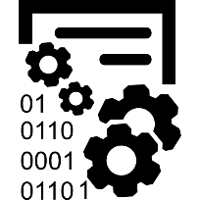

Design Models Cont.
Data Design
Architectural Design
Interface Design
Procedural Design
It transforms structural elements of software into procedural description of software components
It transforms class models into design class realization and prepares data structure (data design) required to implement the software.
It defines the relationship between major structural elements of the software
It defines how software communicates with systems & with humans. An interface implies flow of information & behavior.

Slide 41
Quality attributes of software design
The FURPS quality attributes
F
Functionality
U
Usability
assessed by feature set and capabilities of the program, generality(scope) of the functions & security of overall system
assessed by considering human factors, overall aesthetics(UI/UX), consistency & documentations
R
Reliability
P
Performance
assessed by measuring frequency & severity of failures, accuracy of outputs, mean-time-of-failure (MTTF), ability to recover from errors
measured by processing speed, response time, resource consumption, throughput and efficiency
S
Supportability
Ability to extend program, adaptability, serviceability, testability, compatibility

Slide 42
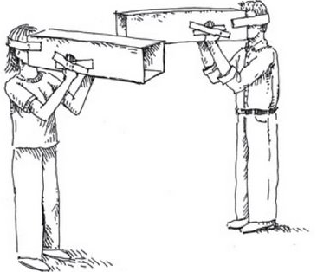

Design Principles
Design process should not suffer from “tunnel vision”
Design should be structured to degrade gently, even when abnormal data, events, or operating conditions are encountered
Design should be traceable to the analysis model
Design should not reinvent the wheel
Design is not coding, coding is not design
Design should “minimize the intellectual distance” between the software and the real world problem
Design should be assessed for quality as it is being created, not after the fact
Design should exhibit (present) uniformity and integration
Design should be reviewed to minimize conceptual (semantic) errors
Design should be structured to accommodate change
Tunnel Vision
Reinvent the Wheel
Coding
Design

Slide 43
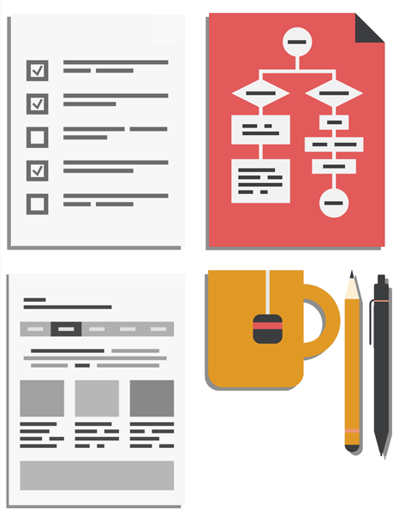

Architectural Design
Software Architecture & Design
Large systems are decomposed into subsystems
Sub-systems provide related services
Initial design process includes
Identifying sub-systems
Establishing a framework for sub-system control and communication
Why to document the Architecture?
Stakeholder Communication: High-level presentation of system
System Analysis: Big effect on performance, reliability, maintainability and other –ilities (Usability, Maintainability, Scalability, Reliability, Extensibility, Security, Portability)
Large-scale Reuse: Similar requirements similar architecture

Slide 44
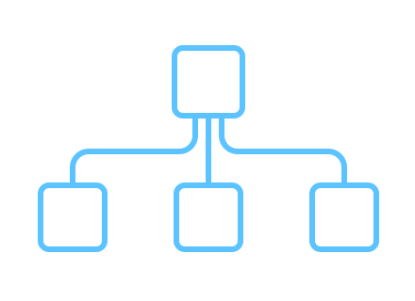

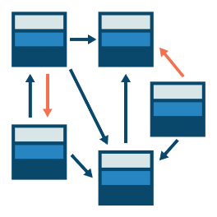
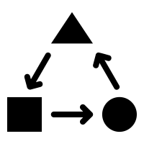
Architectural Styles
Each style describes a system category that encompasses
Data-centered architecture style
Data-flow architectures
A set of components (Ex., a database, computational modules) that perform a function required by a system.
Call and return architecture
Object-oriented architecture
A set of connectors that enable “communication, coordination and cooperation” among components.
Layered architecture
Constraints that define how components can be integrated to form the system.
Semantic models that enable a designer to understand the overall properties of a system.

Slide 45
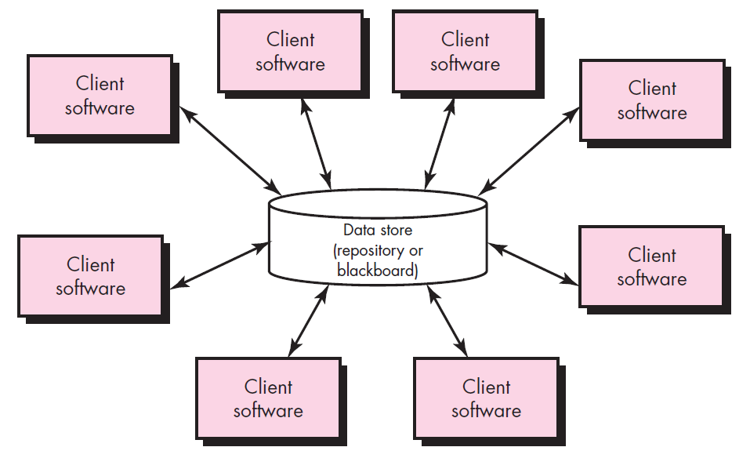
Data-centered architecture style
A data store (Ex., a file or database) resides at the center of this architecture and is accessed frequently by other components.
Client software accesses a central repository.
In some cases the data repository is passive
That is, client software accesses the data independent of any changes to the data or the actions of other client software.

Slide 46





Data-centered architecture example
Physical Banking
Internet Banking
Bank Databases
Store info about accounts, transactions, customers, loans
Mobile Banking
UPI
ATM

Slide 47
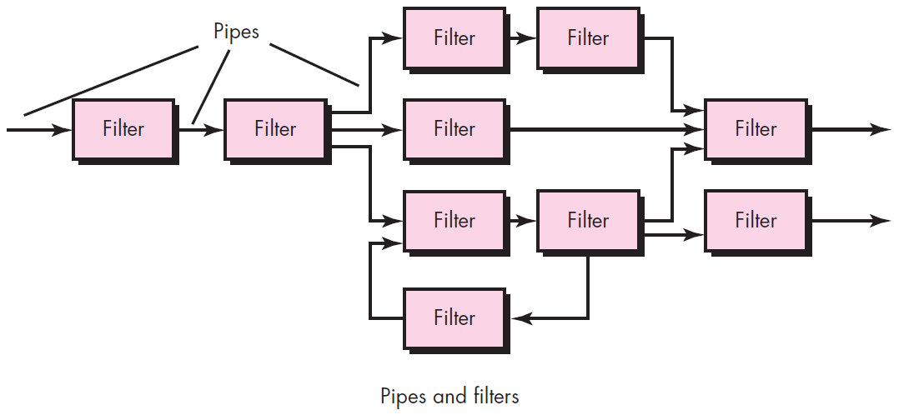
Data-flow architectures
This architecture is applied when input data are to be transformed.
A set of components (called filters) connected by pipes that transmit data from one component to the next.
Each filter works independently of those components upstream and downstream, is designed to
expect data input of a certain form, and
produces data output (to the next filter) of a specified form.

Slide 48
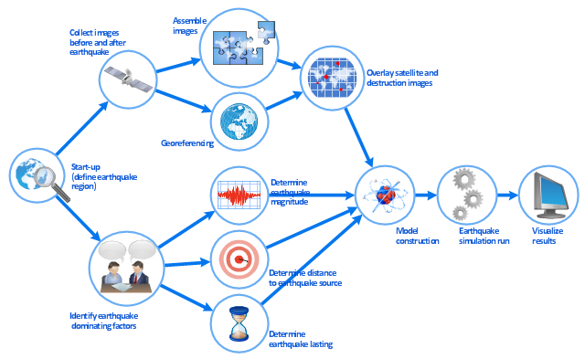
Data-flow architectures example
Earthquake disaster assessment
Source: https://conceptdraw.com/a1551c3/p1/preview/640/pict--work-flow-chart-earthquake-disaster-assessment---workflow-diagram.png--diagram-flowchart-example.png

Slide 49
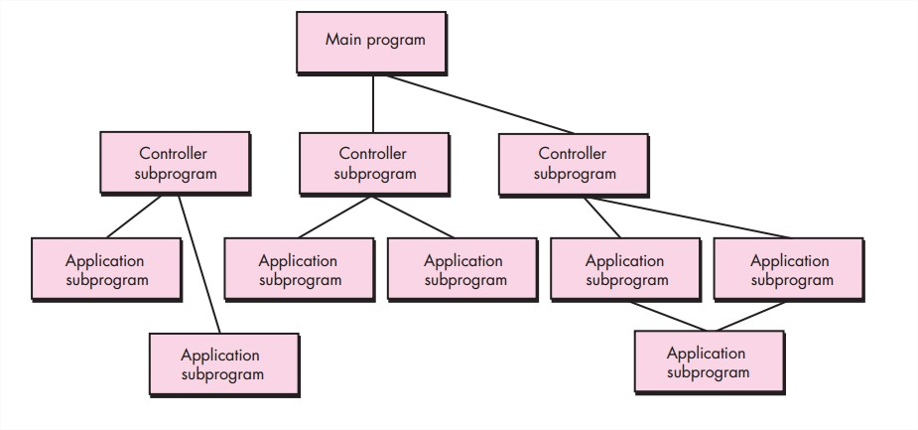
Call and return architecture
This architectural style enables a software designer (system architect) to achieve a program structure that is relatively easy to modify and scale.
A number of sub styles exist within this category as below.
Main program/subprogram architectures
This classic program structure decomposes function into a control hierarchy where a “main” program invokes a number of program components, which in turn may invoke still other components.
Remote procedure call architectures
The components of a main program/subprogram architecture are distributed across multiple computers on a network.

Slide 50
Object-oriented architecture
The components of a system encapsulate data and the operations that must be applied to manipulate the data.
Communication and coordination between components is accomplished via message passing.

Slide 51
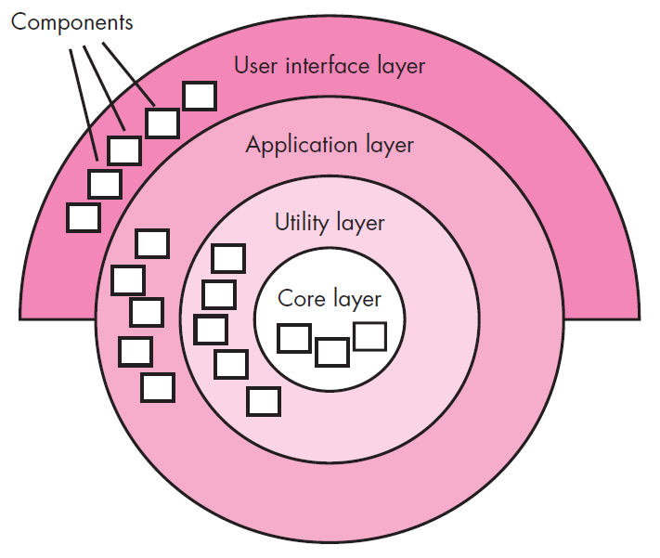
Layered architecture
A number of different layers are defined, each accomplishing operations that progressively become closer to the machine instruction set.
At the outer layer, components service user interface operations.
At the inner layer, components perform operating system interfacing.
Intermediate layers provide utility services and application software functions.

Slide 52
Layered architecture example
Different Layered for a web application.
Presentation Layer
Handles UI and user interaction (e.g., HTML, CSS, JavaScript).
Business Logic Layer
Contains the core functionality and business rules (e.g., Java, C#, Python).
Data Access Layer
Manages data retrieval and storage (e.g., SQL, NoSQL databases).
Database Layer
The actual database management system (e.g., MySQL, MongoDB).

Slide 53

Component Level Design
Component is a modular, deployable and replaceable part of a system that encapsulates implementation and exposes a set of interfaces.
Component-level design occurs after data, architectural and interface designs have been established.
It defines the data structures, algorithms, interface characteristics, and communication mechanisms allocated to each component.
The intent is to translate the design model into operational software.
But the abstraction level of the existing design model is relatively high and the abstraction level of the operational program is low.
Effective programmers should not waste their time in debugging, they should not introduce bug to start with

Slide 54
Function Oriented Approach
The following are the features of a typical function-oriented design approach:
A system is viewed as something that performs a set of functions.
Starting at this high level view of the system, each function is successively refined into more detailed functions.
For example, consider a function create-new-library member
which essentially creates the record for a new member, assigns a unique membership number to him, and prints a bill towards his membership charge.
This function may consist of the following sub-functions:
assign-membership-number, create-member-record and print-bill
Each of these sub-functions may be split into more detailed sub-functions and so on.
The system state is centralized and shared among different functions.
For Ex., data such as member-records is available for reference and updating to several functions such as:
create-new-member
delete-member
update-member-record

Slide 55
Object Oriented Approach
In the object-oriented design approach, the system is viewed as collection of objects (i.e., entities).
The state is decentralized among the objects and each object manages its own state information.
For example, in a Library Automation Software,
each library member may be a separate object with its own data and functions to operate on these data.
In fact, the functions defined for one object cannot refer or change data of other objects.
Objects have their own internal data which define their state.

Slide 56
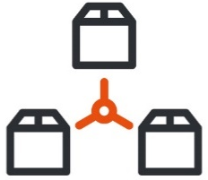



Cohesion & Coupling
A good software design implies clean decomposition of the problem into modules, and the neat arrangement of these modules in a hierarchy.
The primary characteristics of neat module decomposition are high cohesion and low coupling.
Cohesion refers to the degree to which the elements within a module (or class) belong together and work together to fulfill a single purpose.
Coupling refers to the degree of dependence between modules (or classes).

Slide 57
Cohesion
Classification of Cohesion
Cohesion is an indication of the relative functional strength of a module.
A cohesive module performs a single task, requiring little interaction with other components.
Stated simply, a cohesive module should (ideally) do just one thing.
A module having high cohesion and low coupling is said to be functionally independent of other modules.
By the term functional independence, we mean that a cohesive module performs a single task or function.
Classification of Cohesion
Coincidental
Low
Logical
Temporal
Procedural
Communicational
Sequential
Functional
High

Slide 58
Classification of Cohesion cont.
Coincidental cohesion
Logical cohesion
A module is said to have coincidental cohesion, if it performs a set of tasks that relate to each other very loosely.
In this case, the module contains a random collection of functions.
It is likely that the functions have been put in the module out of pure coincidence without any thought or design.
For Ex., Imagine a class Utility that contains a random collection of unrelated methods like
print_current_date()
calculate_sum(a, b)
read_file(filename)
A module is said to be logically cohesive if all elements of the module are logically categorized to do similar things.
For Ex., Imagine a class LogManager that handles different types of logging activities based on a method parameter
log(log_type, message): main function
log_error(message)
log_info(message)
log_debug(message)

Slide 59
Classification of Cohesion cont.
Temporal cohesion
Procedural cohesion
Temporal cohesion occurs when elements of a module are grouped because they are related by the timing of their execution, typically because they are all executed in the same phase of an operation.
For Ex., Imagine a class StartupManager that handles various tasks that need to be executed during the startup phase of an application
initialize(): main function
load_configuration()
connect_to_database()
initialize_logging()
show_startup_message()
Procedural cohesion occurs when elements of a module are grouped together because they follow a specific sequence of execution to achieve a task, even though the tasks are different.
Imagine a class OrderProcessor that handles different steps of processing an order in a sequence
process_order(order): main function
validate_order(order)
calculate_total(order)
process_payment(order)
generate_receipt(order)

Slide 60
Classification of Cohesion cont.
Communicational cohesion
Sequential cohesion
Communicational cohesion occurs when elements of a module are grouped together because they operate on the same data or contribute towards the same piece of data.
Example: A module that calculates statistics like mean, median, and mode from the same dataset.
Sequential cohesion occurs when elements of a module are grouped together because the output from one part serves as the input to the next part in a sequence.
Imagine a class DataPipeline that processes data in a sequence of steps:
process_data(raw_data): main function
clean_data(raw_data)
transform_data(cleaned_data)
analyze_data(transformed_data)
save_results(analyzed_data)

Slide 61
Classification of Cohesion cont.
Functional cohesion
Functional cohesion occurs when all elements of a module are grouped together because they all contribute to a single, well-defined task.
Imagine a class MathOperations that handles the calculation of the area :
calculateCircleArea()
calculateSquareArea()
calculateRectangleArea()

Slide 62
Coupling
Classification of Coupling
Coupling between two modules is a measure of the degree of interdependence or interaction between the two modules.
A module having high cohesion and low coupling is said to be functionally independent of other modules.
If two modules interchange large amounts of data, then they are highly interdependent.
The degree of coupling between two modules depends on their interface complexity.
The interface complexity is basically determined by the number of types of parameters that are interchanged while invoking the functions of the module.
Classification of Coupling
Data
Low
Stamp
Control
Common
Content
High

Slide 63
Classification of Coupling Cont.
Data coupling
Stamp coupling
Two modules are data coupled, if they communicate through a parameter.
An example is an elementary (primal) data item passed as a parameter between two modules, e.g. an integer, a float, a character, etc.
This is a special case (or extension) of data coupling
Two modules (``A'' and ``B'') exhibit stamp coupling if one passes directly to the other a composite data item - such as a record (or structure), array, or (pointer to) a list or tree.
This occurs when ClassB is declared as a type for an argument of an operation of ClassA
Control coupling
If data from one module is used to direct the order of instructions execution in another.
An example of control coupling is a flag set in one module and tested in another module

Slide 64
Classification of Coupling Cont.
Common coupling
Common coupling occurs when multiple modules or components share and depend on a common global data structure or variable.
This can lead to tight interdependencies and make the system harder to maintain.
Imagine a system with a global variable that is accessed by multiple classes
shared_data: A global variable that is accessed by multiple classes
Content coupling
Content coupling happens when one module directly changes or depends on the internal details of another module.
This is the tightest form of coupling and often leads to poor modularity and maintainability.
Imagine two classes where one class directly modifies the internal state of another class
DataHolder Class: Contains a private method _add_data that modifies the internal state of the class.
DataManipulator Class: Directly accesses and uses the _add_data method to modify the internal state of DataHolder.

Slide 65

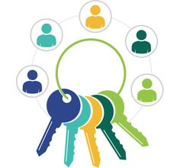

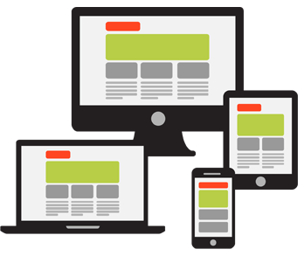
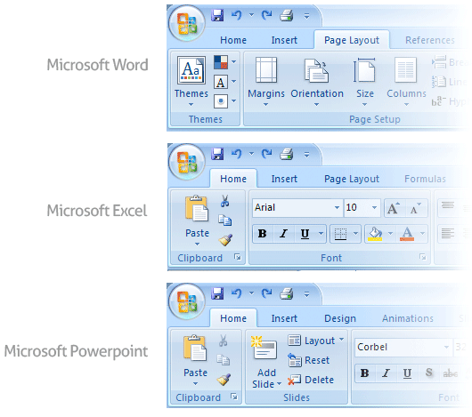
User Interface Design
Golden Rules of User Interface Design
Place the User in Control
Reduce the User’s Memory Load
Make the Interface Consistent

Slide 66
Place the User in Control
During a requirements-gathering session for a major new information system, a key user was asked about.
Following are the design principles that allow the user to maintain control
Define the interaction modes in such a way that does not force the user into unnecessary or undesired actions
The user should be able to easily enter and exit the mode with little or no effort.
Provide for flexible interaction
Different people will use different interaction mechanisms, some might use keyboard commands, some might use mouse, some might use touch screen, etc.,
Allow user interaction to be interruptible and undoable
When a user is doing a sequence of actions the user must be able to interrupt the sequence to do some other work without losing the work that had been done.
The user should also be able to do an undo operation.

Slide 67
Place the User in Control
Streamline interaction as skill level advances and allow the interaction to be customized
Advanced or highly skilled users should be provided a chance to customize the interface as user want which allows different interaction mechanisms so that the user doesn’t feel bored while using the same interaction mechanism.
Hide technical internals from casual users
The user should not be aware of the internal technical details of the system. He should interact with the interface just to do his work.
Design for direct interaction with objects that appear on-screen
The user should be able to use the objects and manipulate the objects that are present on the screen to perform a necessary task.
By this, the user feels easy to control over the screen.

Slide 68
Reduce the User’s Memory Load
The more a user has to remember, the more error-prone the interaction with the system will be.
Following are the design principles that enable an interface to reduce the user’s memory load
Reduce demand on short-term memory
When users are involved in some complex tasks the demand on short-term memory is significant.
So the interface should be designed in such a way to reduce the remembering of previously done actions, given inputs, and results.
Establish meaningful defaults
Always an initial set of defaults should be provided to the average user, if a user needs to add some new features then he should be able to add the required features.
Define shortcuts that are intuitive(easy to understand)
Mnemonics(assisting) should be used by the user. Mnemonics means the keyboard shortcuts to do some action on the screen.

Slide 69

Reduce the User’s Memory Load
The visual layout of the interface should be based on a real-world metaphor
Anything you represent on a screen if it is a metaphor for a real-world entity then users would easily understand.
Disclose information in a progressive fashion
The interface should be organized hierarchically i.e., on the main screen the information about the task, an object or some behavior should be presented first at a high level of abstraction. More detail should be presented after the user indicates interest with a mouse pick.

Slide 70
Make the Interface Consistent
The interface should present and acquire information in a consistent fashion.
Following are the design principles that help make the interface consistent
Allow the user to put the current task into a meaningful context
Many interfaces have dozens of screens.
So it is important to provide indicators consistently so that the user know about the doing work.
The user should also know from which page has navigated to the current page and from the current page where it can navigate.
Maintain consistency across a family of applications
In The development of some set of applications all should follow and implement the same design, rules so that consistency is maintained among applications.
If past interactive models have created user expectations do not make changes unless there is a compelling reason.

Slide 71

User Interface Analysis and Design Models
User profile model – Established by a software engineer
Establishes the profile of the end-users of the system
based on age, gender, physical abilities, education, cultural background, motivation, goals, and personality.
Design model – Created by a software engineer
Derived from the analysis model of the requirements.
Incorporates data, architectural, interface, and procedural representations of the software.
Implementation model – Created by the software implementers
Consists of the look and feel of the interface combined with all supporting information (books, videos, help files) that describe system syntax and semantics.
User's mental model – Developed by the user when interacting with the application
Often called the user's system perception.
Consists of the image of the system; that users carry in their heads.
The role of the interface designer is to merge these differences and derive a consistent representation of the interface.

Slide 72

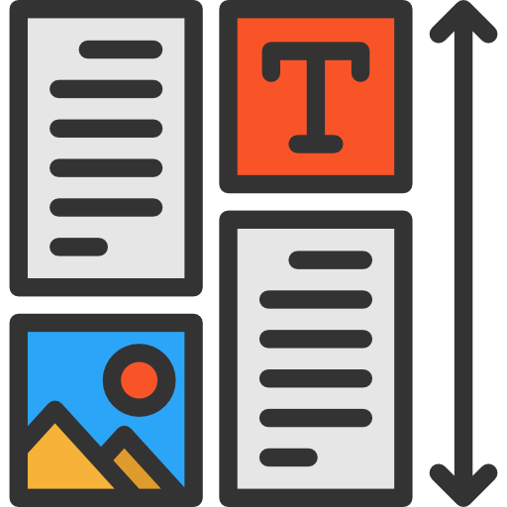
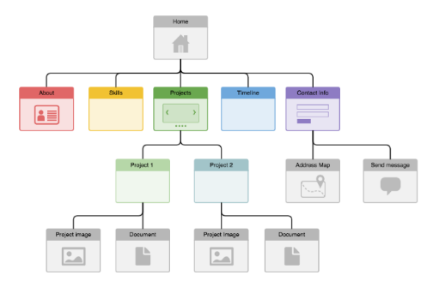


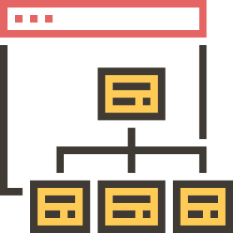
Web Application Design
Design for WebApp encompasses technical and nontechnical activities that include:
Establishing the look and feel of the WebApp
Defining the overall architectural structure
Developing the content and functionality that reside within the architecture
Planning the navigation that occurs within the WebApp

Slide 73
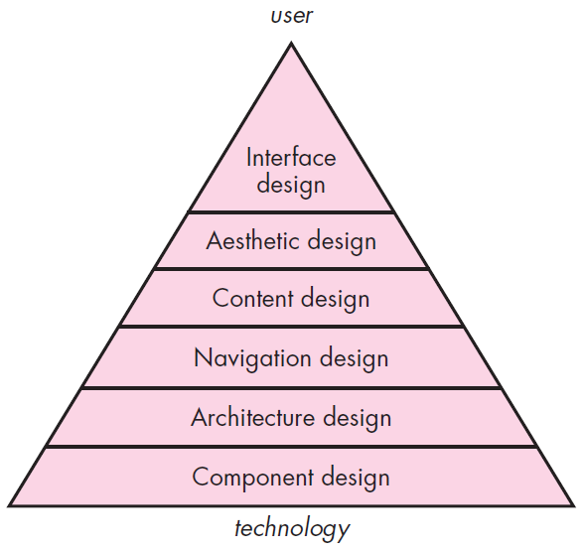
Web App Interface Design
Design pyramid for WebApps
The objectives of a WebApp interface are to
Establish a consistent window into the content and functionality provided by the interface.
Guide the user through a series of interactions with the WebApp.
Organize the navigation options and content available to the user
Interface Design
One of the challenges of interface design for WebApps is the nature of the user’s entry point.

Slide 74
Design pyramid for WebApps Cont.
Aesthetic Design
Content Design
Architecture Design
Also called graphic design, is an artistic endeavor sthat complements the technical aspects of WebApp design.
Generate content and design the representation for content to be used within a WebApp.
It represent the overall hypermedia structure
Component-Level Design
Navigation Design
Modern WebApps deliver increasingly sophisticated processing functions that
Represents the navigational flow between content objects and for all WebApp functions. It describes how the user locates and interacts with the content.
Perform localized processing to generate content and navigation capability in a dynamic fashion
Provide computation or data processing capability that are appropriate for the WebApp’s business domain
Provide sophisticated database query and access
Establish data interfaces with external corporate systems

Slide 75
Question
Sr. No. | Title
1 | Explain Requirement Engineering Tasks. OR Write a short note on Requirement Engineering.
2 | Write functional and non-functional requirements of Hotel Management System OR List five functional requirement of Library management System.
3 | Enlist characteristic of SRS. Write a SRS for Hospital management system
4 | State the difference between procedural Design and Object-Oriented Design.
5 | Explain Quality Function Deployment (QFD).
6 | List and explain Characteristics of a Good SRS.
7 | What is the work product of software design process and who does this?
8 | How requirements are classified? list them with an example for each
9 | What is activity diagram and Swim-lane? Draw activity diagram for book issue in library management.
10 | Give a use case diagram for an online shopping which should provide provisions for registering authenticating the customers

Slide 76
Question
Sr. No. | Title
11 | Differentiate Procedural Design and Object Oriented Design
12 | What is Architectural Design? Enlist different styles and patterns of architecture.
13 | What is Object Oriented Design of a system? Draw the Use case diagram and Class diagram for Library Management system.
14 | Describe Golden Rules of User Interface Design
15 | Explain Design pyramid for WebApps
16 | Compare Coupling and Cohesion. Explain different types of Coupling and its effects on software modules.
17 | List out the various types of cohesion and coupling.

Slide 77
Software Engineering
(#2301CS405)
Prof. R. B. Gondaliya
Computer Engineering Department
Rajkumar.gondaliya@darshan.ac.in
+ 91-9723232741

